Slide 1
USER ANALYSIS
Exploring the valuable target customer’s groups

Slide 2
First touch – problem statement
We want to focus on Breakfast cuisine in smaller cities of Greece. More specifically Breakfast via efood seems to be the “hot” thing for users of the app.
We want to explore the possibilities we have on exploiting the most out of this new trend and how we can enhance its effect on other types of cuisines, users and groups.
Steps towards an analytical solution:
Exploring and analyzing the trends around breakfast ordering.
Exploring the possible relationships of this trend with other factors and features.
Creating clients’ groups/segments.
Analyzing results; other possible approaches;

Slide 3
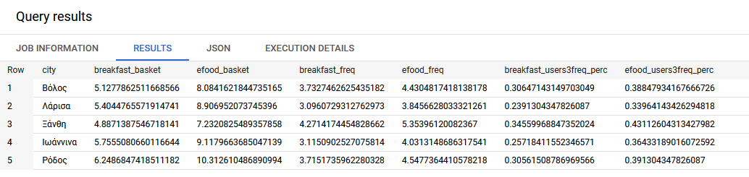
Exploring and analyzing the trends around breakfast ordering
Firstly, we try to “read” the data derived from our SQL data manipulation, from which we got a valuable table:
Valuable results:
The top 5 cities (smaller cities of Greece) regarding the frequency of the orders per user and the amount spent per order, are in the mainland (something expected) but also something to consider. Probably on summer months this view changes and the islands take the lead(?) .
The breakfast_basket column which shows the amount spent per order is almost the two thirds (2/3) of the total efood_basket, that is almost 63% of the total efood_basket for the top 5 cities
The same applies to the breakfast_freq compared to the total efood_freq for the top 5 cities for which we see that the orders per user make up for a big percentage of the efood_freq.

Slide 4
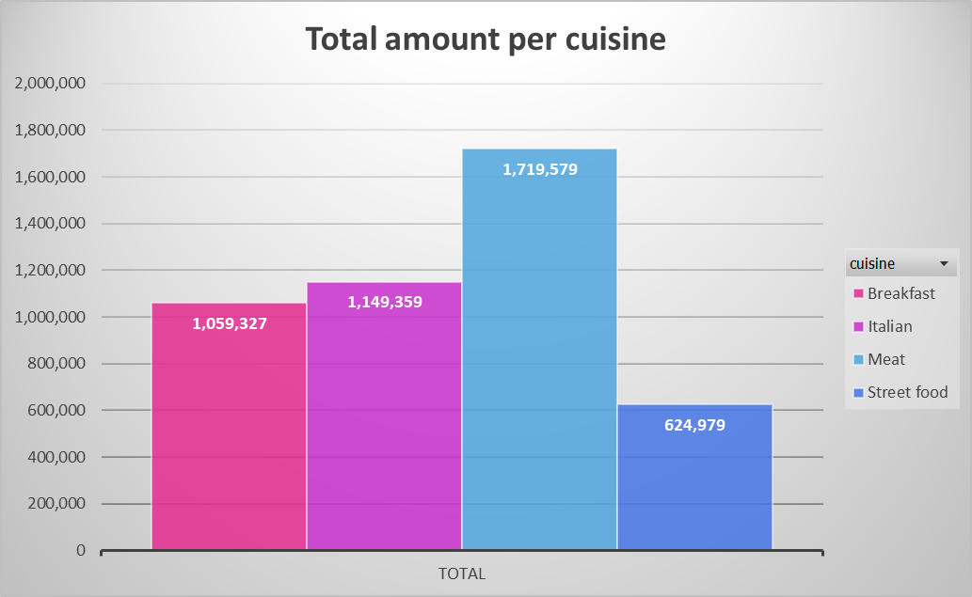
Possible relationships of this trend with other factors and features.
Traditionally breakfast was a meal that was a part of the indoors food experience for someone especially in Greece which is usually a fast meal for the vast majority. Additionally, there was and still is an important amount that acquires fast food breakfast from small bakeries on-site.
Although through online ordering, the last years, breakfast became a contributor towards the total increase of the efood basket. Moreover, the outburst of the pandemic changed the scenery (for the best) and it is something to keep in mind. Due to the lockdowns and the new (international) trends and standards for the “brunch” section made breakfast a must-order meal.
In the chart on the right, we see the amount
that Breakfast is responsible for, compared
with other cuisines for January 2022.

Slide 5
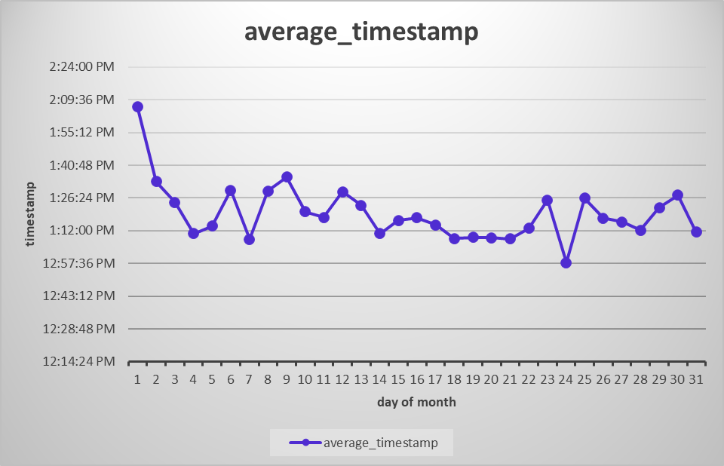
Possible relationships of this trend with other factors and features.
Furthermore on our exploration we need to consider other factors, such as the work from home (wfh) situation that seems to take over, against the conventional ways of working. That makes users to order breakfast as they can now take this meal not early in the morning as they should have done if they were to commute to work. This is depicted to the following chart/analysis. The table that was the data feed for this chart, was built in the Power Query tool.
As we see in the chart on the left the average timestamp for the breakfast orders is after 12:00 at noon, and even later, which indicates that the new norm of ordering breakfast takes over probable timestamps of other cuisines/meals.

Slide 6
Creating clients’ groups/segments
01
02
03
Data Selection
Data manipulation and methods used
We chose to work on the orders data. Although a first touch analysis was conducted with the output data from the SQL-induced table but the results were not indicative
Regarding the technical side of the analysis we implemented the Kmeans method for finding clusters and tried different combination of the given dataset. More on these can be found on the notebook file attached.
Results
We produced a graphical visualisation of the data in order to deduct insightful conclusions

Slide 7
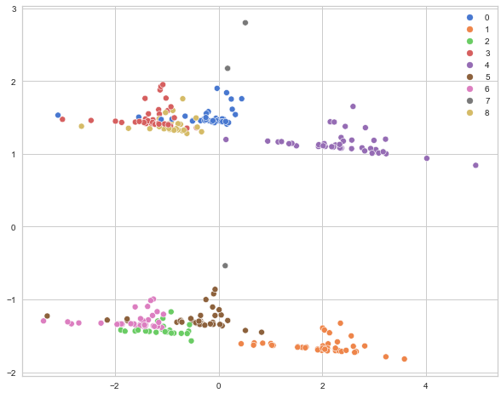
Analyzing results; other possible approaches;
On the graph are depicted the clusters that were created from our method’s implementation. We created 9 clusters, from which we can deduct segments for the users.
Although this cannot be done with this plot as it is diffucult to interpret.
Therefore, we created a more meaningful visualization…

Slide 8
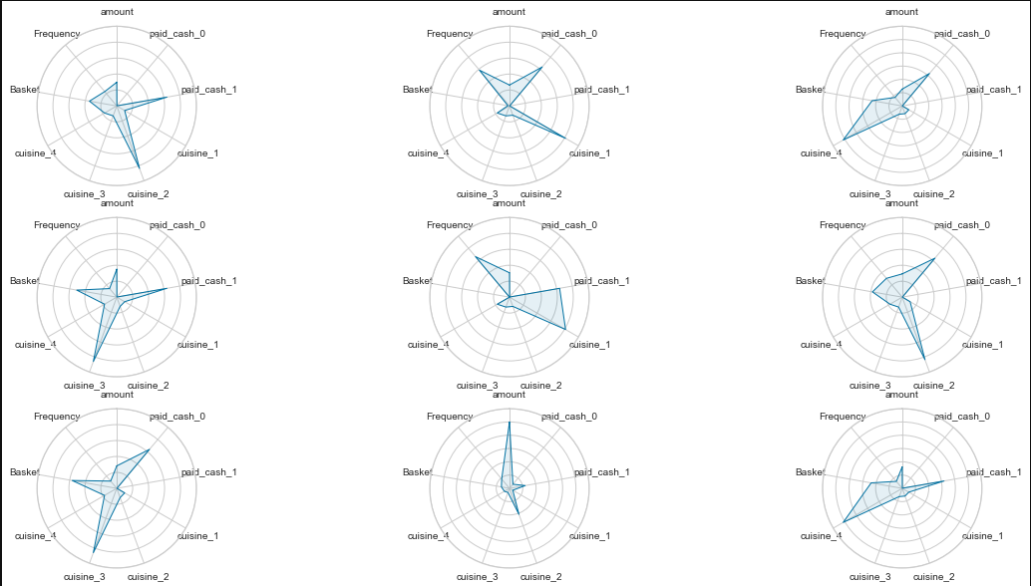
Analyzing results; other possible approaches;

Slide 9
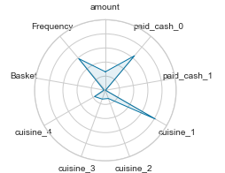
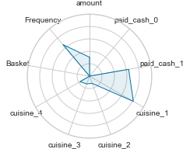
Analyzing results; other possible approaches;
From the previous graph we can deduct useful insights as we can create target groups for the Marketing campaigns. Let’s look in detail some useful clusters.
This visualization shows that there is a cluster/segment that contains the users of cuisine_1 (Brekfast). So this segment contains users with high preference in paying with credid card (paid_cash_0) and have many orders (orders per user or frequency). Moreover there is a small tendency in choosing other cuisines as well.
1
These 2 segments are actually the same coin, but from 2 different sides, that is users that choose breakfast and pay with cash or not
This visualization shows that there is a cluster/segment that contains the users of cuisine_1 (Brekfast). So this segment contains users with high preference in paying with cash(paid_cash_1) and have many orders (orders per user or frequency). Moreover there is a small tendency in choosing other cuisines as well.
2

Slide 10
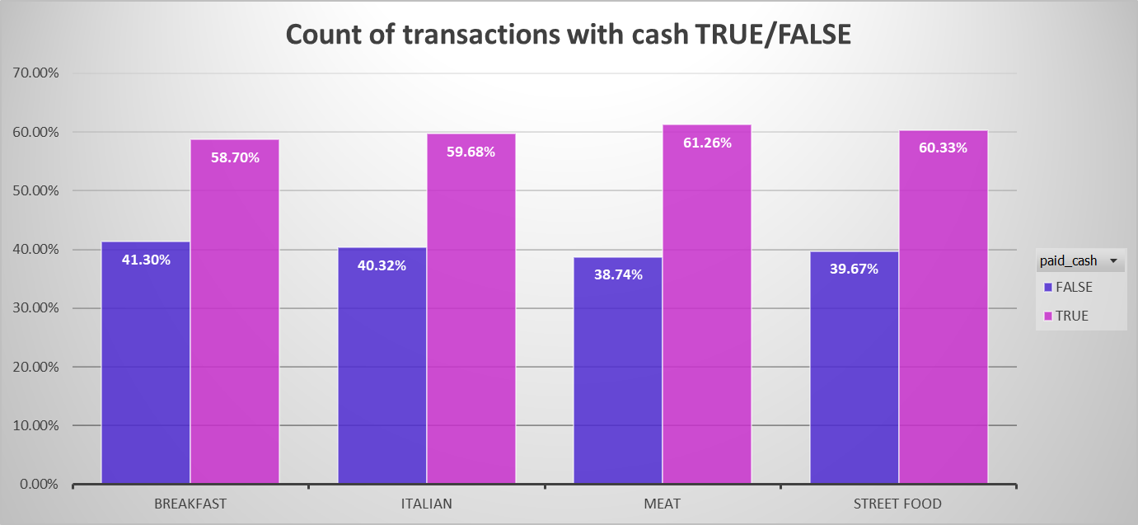
Analyzing results; other possible approaches;
From the previous analysis we can see that the breakfast-users are users with the following characteristics:
Tendency on frequency (orders per user).
Pay method is almost split, with cash being the preferred method, but we can see it is a bit higher compared with the other cuisines.
From the above we can create a profile of the right target group!

Slide 11
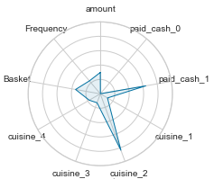
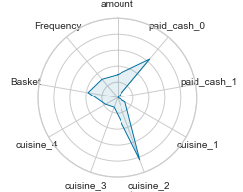
Analyzing results; other possible approaches;
From the previous graph we can deduct useful insights ad we can create target groups for the Marketing campaigns. Let’s look in detail some useful clusters.
This visualization shows that there is a cluster/segment that contains the users of cuisine_2 (Meat). So this segment contains users with high preference in paying with cash (paid_cash_1) and have many orders orders per user or frequency. This shows that they are loyal as the breakfast-users.
3
These 2 segments are actually the same coin, but from 2 different sides, that is users that choose breakfast and pay with cash or not
This visualization shows that there is a cluster/segment that contains the users of cuisine_2 (Meat). So this segment contains users with high preference in paying with credit card (paid_cash_0) and have many orders orders per user or frequency. This shows that they are loyal as the breakfast-users.
4

Slide 12
Analyzing results; other possible approaches;
So we could conclude that a “safe” choice for a target group from Marketing’s perspective could be the group contained in Cuisine parent: Meat
In the other groups we see low score in the characteristics that the breakfast users have. Although this is another approach to our problem. That is if the Marketing team wants to apply and implement a campaign and “bring” other kind of users to the “breakfast” side.
However, since the campaign is focused on creating more loyal clients, we can target users that mentioned above, with similar characteristics as the ones that the breakfast users have.

Slide 14
THANKS!
Do you have any questions?
addyouremail@freepik.com +91 620 421 838 yourcompany.com
Please keep this slide for attribution

